Slide 1

Study & Analysis of Household WiFi Speed
Huafeng Zhang

Slide 2

Questions of Interest
并列关系
1
2
3
4
Does the distance
between WiFi
router and WiFi
users affect the
WiFi speed?
Obstacles
Distance
# of WiFi Users
Interaction
Do obstacles affect WiFi speed?
How does the number of WiFi users affect WiFi speed?
Is there any interaction among these three factors on WiFi speed?

Slide 3


Study Design— Three-factor Factorial CRD
Response: download speed;
Response unit: Mbps;
n:5, N:120.
Other issues:
Ran this experiment in the early morning ;
Turned off Microwave and other devices.
10 ft
30 ft
50 ft
#
Obstacle:
With or without;
Obstacle was simulated using a computer monitor and a board;
between WiFi router and WiFi users.
#
Distance:
10, 30, 50 feet;
Was measured in a straight line free of obstacle;
Set a table between different distances.
# of WiFi Users:
1, 2, 3, 4
All Apple Devices;
All used Google Incognito to connect testmy.net
only allowed to download the same file (12 MB data) at the same time.

Slide 4
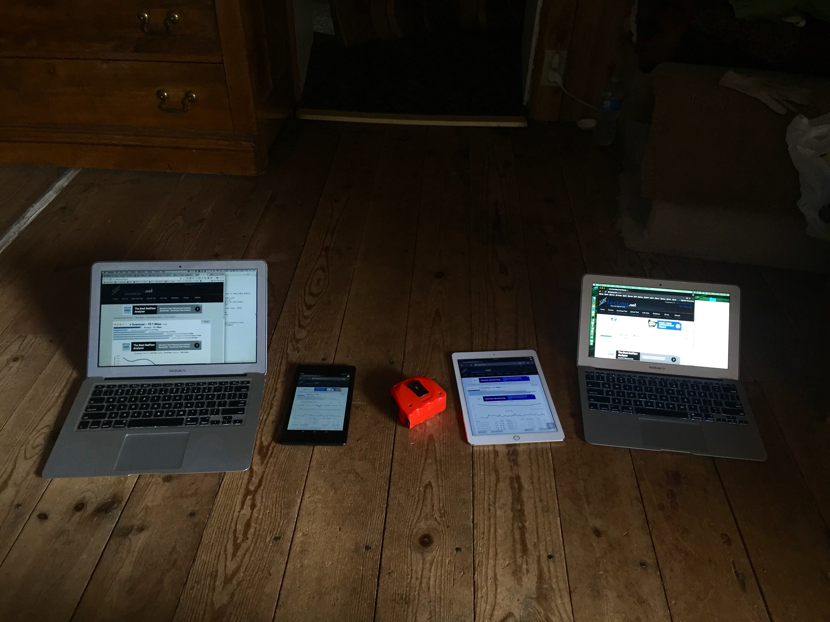
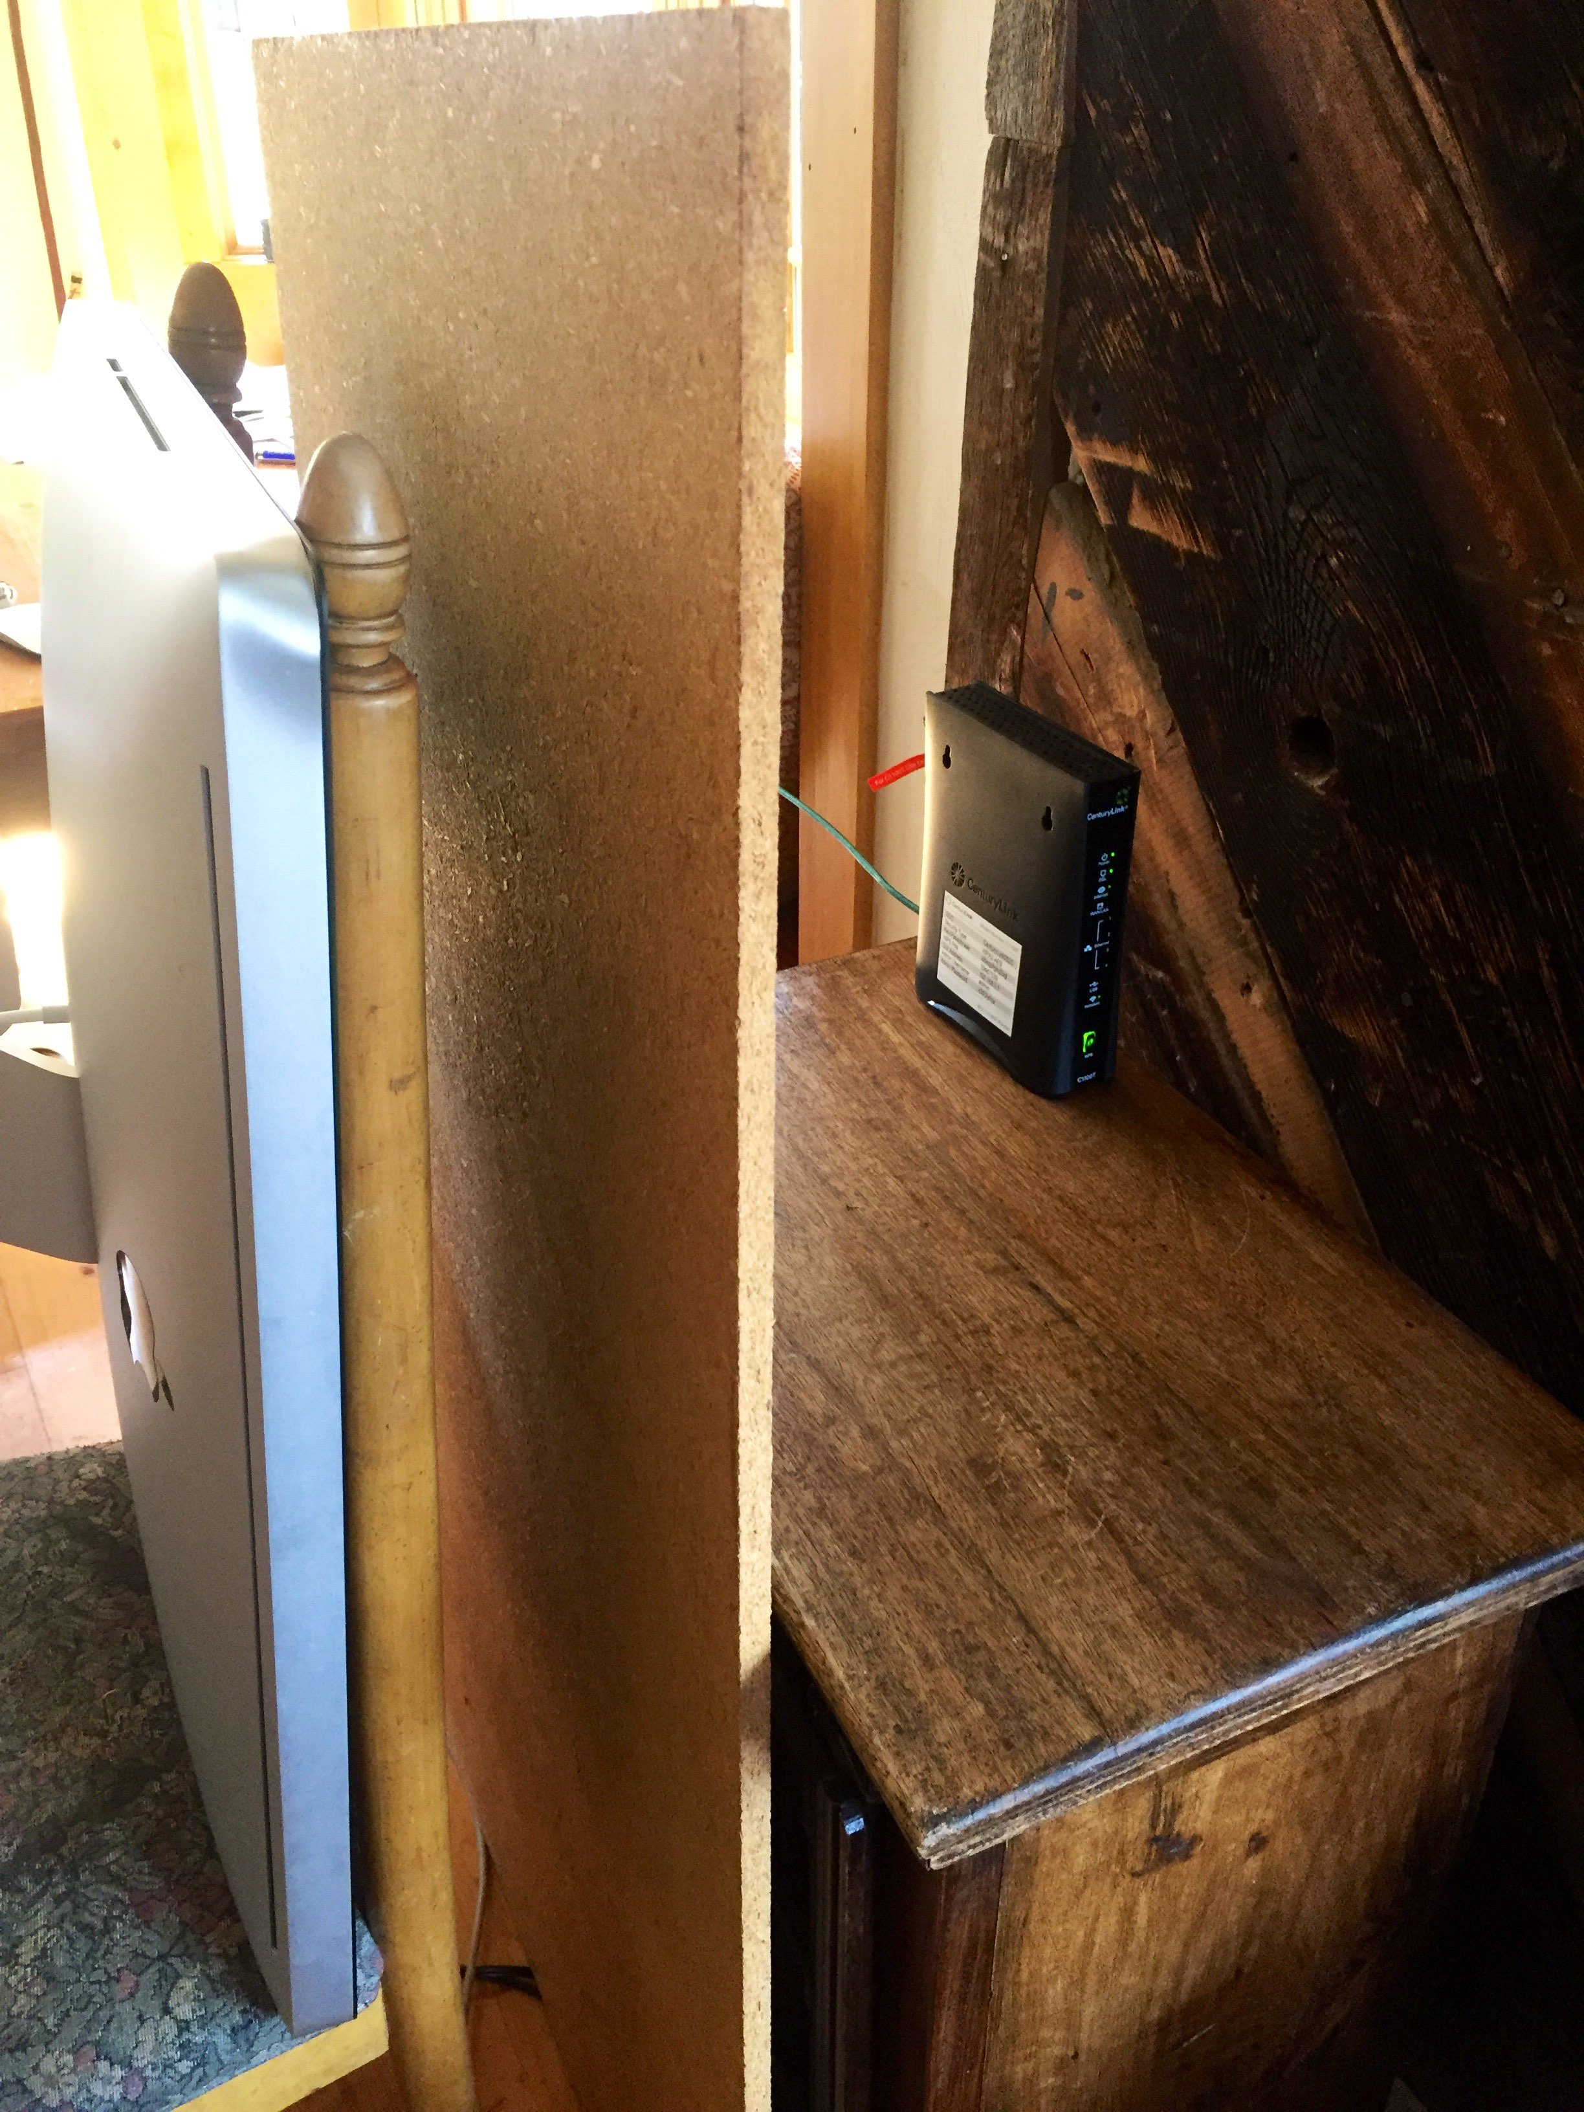


Pics during Experiment

Slide 5
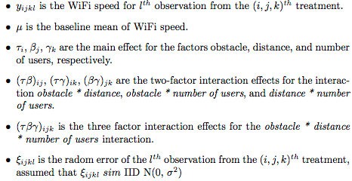
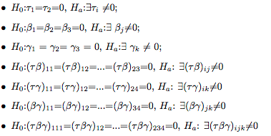
Model
Model Descriptions
Hypotheses

Slide 6
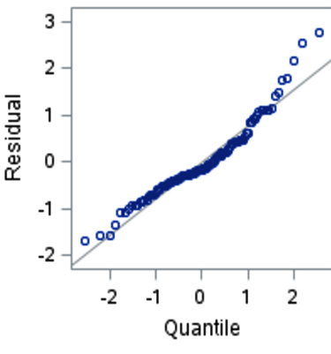
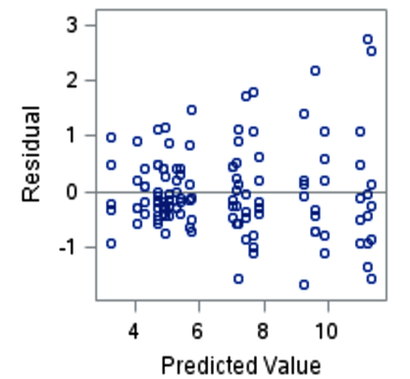
Assumptions
Homogeneity of Variance
Normality

Slide 7
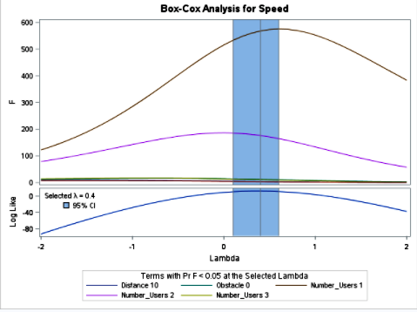
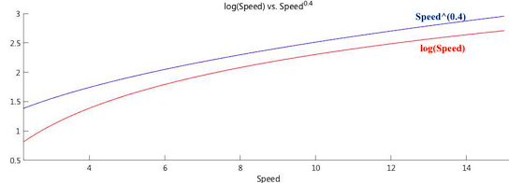
Box-Cox Transformation
The result suggests that λ=0.4, that is, the response Speed will be transformed to Speed^{0.4} in order to maximize R².
However, Speed^{0.4} and log(Speed) are very close within the range of my WiFi speed (2-15), and R² for log(Speed) is 0.9144, which is very close to the R² for Speed^{0.4} (0.9149).
It is easier to interpret the results when using log(Speed). So I transformed speed to log(Speed).

Slide 8
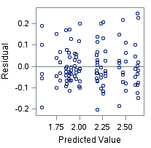
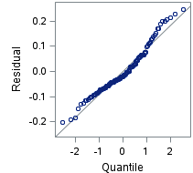
Diagnostics Plots for transformed Data
Homogeneity of Variance
Normality

Slide 9
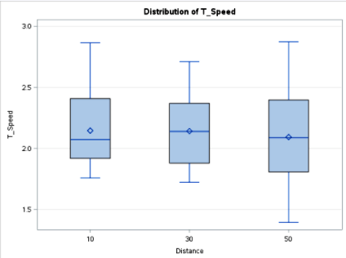
Results— Distance
Model Summary
R Squared | 0.9144
Model DF | 23
Error DF | 96
Root MSE | 0.1189
Source | DF | Type III SS | Mean Square | F value | Pr>F
Distance | 2 | 0.1438 | 0.0719 | 5.08 | 0.008

Slide 10
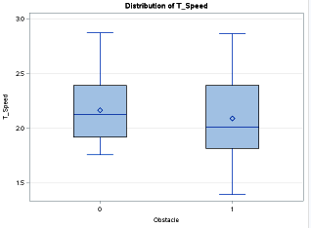
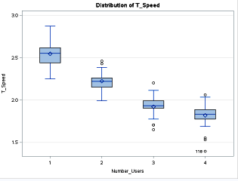
Results—Obstacle, Number_Users
Source | DF | Type III SS | Mean Square | F value | Pr>F
Obstacle | 1 | 0.3017 | 0.3017 | 21.32 | <0.0001
Number_Users | 3 | 13.0712 | 4.3572 | 307.93 | <0.0001

Slide 11
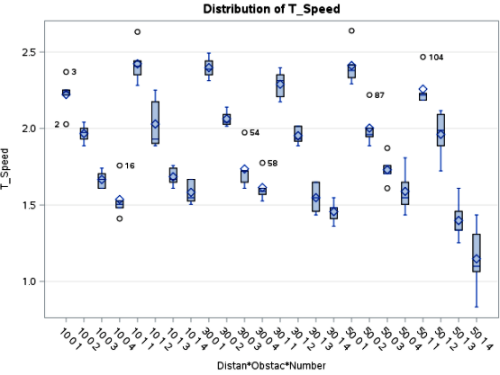
Results—Interactions
Source | DF | Type III SS | Mean Square | F value | Pr>F
Obstacle*Distance*Number_Users | 6 | 0.1288 | 0.0215 | 1.52 | 0.1807
Distance*Obstacle | 2 | 0.5499 | 0.2749 | 19.43 | <0.0001
Distance*Number_Users | 6 | 0.1437 | 0.0239 | 1.69 | 0.1310
Obstacle*Number_Users | 3 | 0.1706 | 0.0569 | 4.02 | 0.0097

Slide 12
Post-Hoc Power Analysis
Source | Test DF | Power
Distance | 2 | 0.477
Obstacle | 1 | 0.929
Distance*Obstacle | 2 | 0.997
Number_Users | 3 | >0.999
Distance*Number_Users | 6 | 0.293
Obstacle*Number_Users | 3 | 0.484
Distance*Obstacle*Number_Users | 6 | 0.352
Dependent Variable | log(Speed)
Alpha | 0.05
Error Standard Deviation | 0.1189
Test Sample Size | 120
Error Degrees of Freedom | 96
1
2
3
This study has great power in finding effects of Obstacle (power = 0.929), Distance*Obstacle (power > 0.997), and Number_Users (power > 0.999) on the mean of log(Speed), if these effects actually exists.
This study design has moderate power in detecting an effect of Distance (power = 0.477) and Obstacle*Number_Users (power = 0.484) on the mean of log(Speed), if these effects actually exists.
Although the power for Distance*Number_Users (power = 0.293), Distance*Obstacle*Number_Users (power = 0.352) are relatively lower than other terms in the model, these two power are not extremely low.

Slide 13
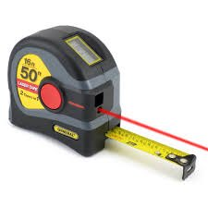
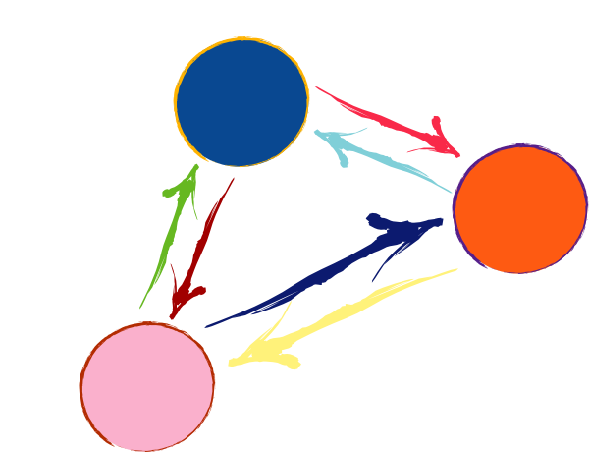
Conclusions
Distance
Number of Users
nUm
There is moderate evidence that the distance between WiFi router and WiFi users has effects on the mean of log(Speed).(F(2, 96) = 5.08, p-value = 0.008)
There is strong evidence against the null hypothesis that there is no effect of the number of WiFi users on the mean of log(Speed). (F(3,96) = 307.93, p-value < 0.0001)
Interactions
Obstacle
No evidence for interaction:
Distance*Number_User (p-value=0.131);
Distance*Obstacle*Number_User (p-value=0.1807).
Moderate evidence of interaction:
Obstacle*Number_User (p-value=0.01)
Strong evidence of interaction:
Distance*Obstacle (p-value<0.0001)
There is strong evidence that obstacle has effects on the mean of log(Speed) (F(1, 96) = 21.32, p-value < 0.0001).

Slide 14
Issues
Design
Analysis
Use representative Apple laptops to record the data;
Use a pilot study and post-hoc power analysis to get sample size for desired power;
Do a little bit more research about the normal file size for people to download.
If time allows, use practical significant difference while analyzing data;
Interpret results using origin scale;
Use orthogonal contrast test to find the relationship between distance and WiFi speed.

Slide 15

Questions

